Slide 1
Informed searching

Slide 2
Informed search
Blind search algorithms do not consider any information about the states and the goals
Often there is extra knowledge that can be used to guide the search
Idea: use an evaluation function f(n) for each node
Implementation:
Order the nodes in fringe by f(n) (by desirability, lowest f(n) first)
Note: evaluation function is an estimate of node quality

Slide 3
Heuristic function
Heuristic:
Definition: “using rules of thumb to find answers”
Heuristic function h(n)
Estimate of (optimal) cost from node ‘n’ to goal
h(n) = 0 if n is a goal node
Example: straight line distance between cities
Note that this is not the true state-space distance
It is an estimate – actual state-space distance can be higher
Provides problem-specific knowledge to the search algorithm

Slide 4
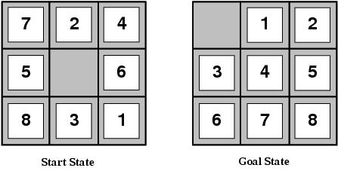
Heuristic functions for 8-puzzle
Two commonly used heuristics
h₁ = the number of misplaced tiles
h₁(s)=8
h₂ = the sum of the distances of the tiles from their goal positions (Manhattan distance).
h₂(s)=3+1+2+2+2+3+3+2=18

Slide 5
Greedy best-first search
Idea: always choose the path on the frontier with the smallest h value.
Best First Search treats the frontier as a priority queue ordered by h.
Greedy approach: expand path whose last node seems closest to the goal

Slide 6
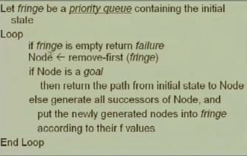
Greedy best-first search

Slide 7
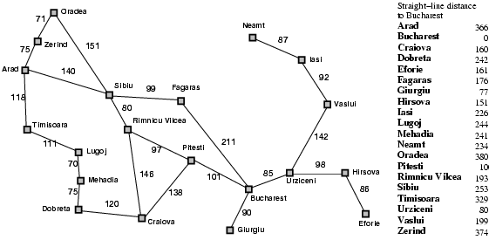
Romania with step costs in km

Slide 8

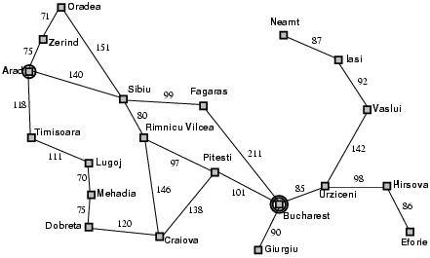
Greedy best-first search example

Slide 9
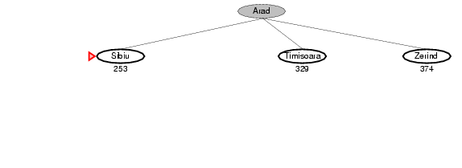
Greedy best-first search example

Slide 10
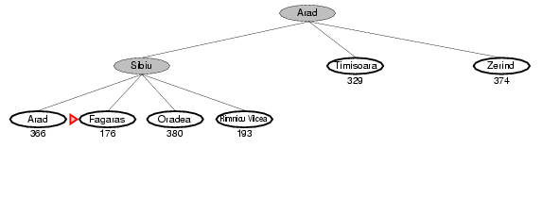
Greedy best-first search example

Slide 11
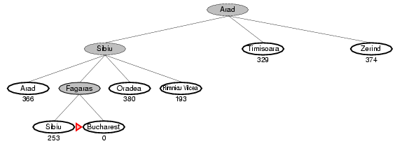
Greedy best-first search example

Slide 12
Optimal Path

Slide 13
Properties of greedy best-first search
Complete?
No
Optimal?
No
Time complexity?
O(b^{m}), can generate all nodes at depth m before finding solution
m = maximum depth of search space
Space complexity?
O(b^{m}) – again, worst case, can generate all nodes at depth m before finding solution

Slide 14
What’s Next?
Thus, having estimates of the distance to the goal can speed things up a lot, but by itself it can also mislead the search (i.e. Best First Search)
On the other hand, taking only path costs into account allows UCSF to find the optimal solution, but the search process is still uniformed as far as distance to the goal goes.
We will see how to leverage these two elements to get a more powerful search algorithm, A*

Slide 15
A* Search
Expand node based on estimate of total path cost through node
Evaluation function f(n) = g(n) + h(n)
g(n) = cost so far to reach n
h(n) = estimated cost from n to goal
f(n) = estimated total cost of path through n to goal
Efficiency of search will depend on quality of heuristic h(n)

Slide 16

A* search example

Slide 17
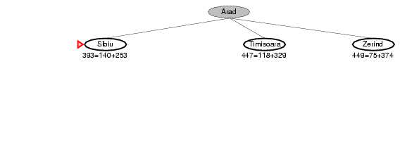
A* search example

Slide 18
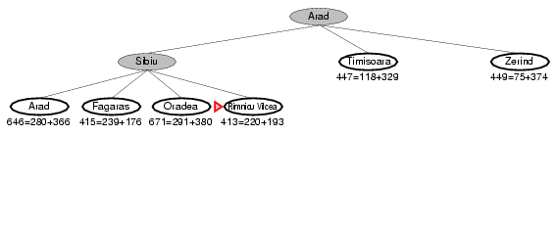
A* search example

Slide 19
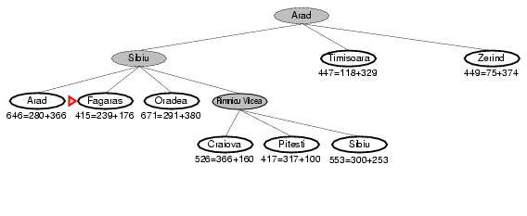
A* search example

Slide 20
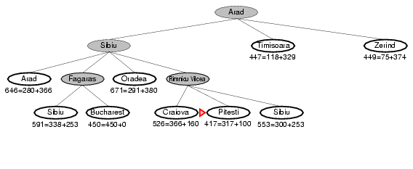
A* search example

Slide 21
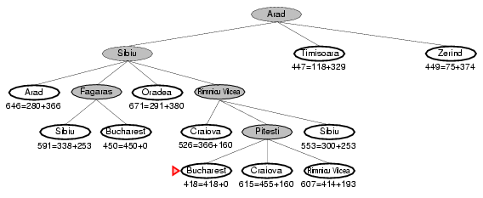
A* search example

Slide 22
Admissible heuristics
A heuristic h(n) is admissible if for every node n,
h(n) ≤ h*(n), where h*(n) is the true cost to reach the goal state from n.
An admissible heuristic never overestimates the cost to reach the goal.
Example: h_{SLD}(n) is admissible
never overestimates the actual road distance
Theorem:
If h(n) is admissible, A* using TREE-SEARCH is optimal

Slide 23
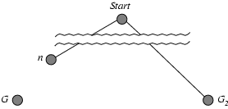
Optimality of A* (proof)
.
f(G₂) = g(G₂) since h(G₂) = 0
g(G₂) > g(G) since G₂ is suboptimal
f(G) = g(G) since h(G) = 0
f(G₂) > f(G) from above

Slide 24
Optimality of A* (proof)
f(G₂) > f(G) from above
h(n) ≤ h*(n) since h is admissible
g(n) + h(n) ≤ g(n) + h*(n)
f(n) ≤ f(G)
Hence f(G₂) > f(n), and A* will never select G₂ for expansion

Slide 25
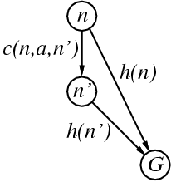
Optimality for graphs?
Admissibility is not sufficient for graph search
In graph search, the optimal path to a repeated state could be discarded
Can fix problem by requiring consistency property for h(n)
A heuristic is consistent if for every successor n' of a node n generated by any action a,
h(n) ≤ c(n,a,n') + h(n')
admissible heuristics are generally consistent
If h(n) is consistent, A* using
GRAPH-SEARCH is optimal

Slide 26
A* is optimal with consistent heuristics
If h is consistent, we have
f(n') = g(n') + h(n')
= g(n) + c(n,a,n') + h(n')
≥ g(n) + h(n)
= f(n)
i.e., f(n) is non-decreasing along any path.
Thus, first goal-state selected for expansion must be optimal

Slide 27
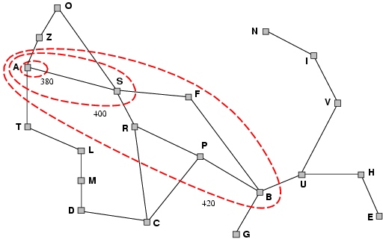
Contours of A* Search
A* expands nodes in order of increasing f value
Gradually adds "f-contours" of nodes
Contour i has all nodes with f=f_{i}, where f_{i} < f_{i+1}

Slide 28
With uniform-cost (h(n) = 0, contours will be circular
With good heuristics, contours will be focused around optimal path

Slide 29
Properties of A*
Complete?
Yes (unless there are infinitely many nodes with f ≤ f(G) )
Optimal?
Yes
Also optimally efficient:
No other optimal algorithm will expand fewer nodes, for a given heuristic
Time?
Exponential in worst case
Space?
Exponential in worst case

Slide 30
Memory-bounded heuristic search
A* expands all nodes with f(n) < C*
This can still be exponentially large
In practice A* runs out of memory before it runs out of time
Idea: Try something like depth first search.

Slide 31
Iterative Deepening A* (IDA*)
Search depth-first, but to a fixed depth, as we did for Iterative Deepening
if you don't find a solution, increase the depth tolerance and try again
depth is measured in f(n)

Slide 32
Analysis of Iterative Deepening A* (IDA*)
Complete and optimal? Yes, under the same conditions as A*
h is admissible
all arc costs > 0
finite branching factor
Time complexity: O(b ^{m})
Space complexity: O(bm)
Same argument as for Iterative Deepening DFS

Slide 33
Recursive Best-First Search (RBFS)
Similar to DFS, but keeps track of the f-value of the best alternative path available from any ancestor of the current node
If current node exceeds f-limit -> backtrack to alternative path
As it backtracks, replace f-value of each node along the path with the best f(n) value of its children
This allows it to return to this subtree, if it turns out to look better than alternatives

Slide 34
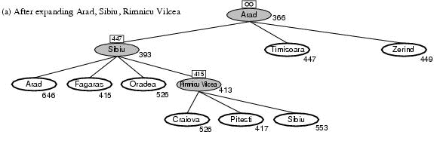
Recursive Best First Search: Example
The path is followed until Pitesti which has a f-value worse than the f-limit.

Slide 35
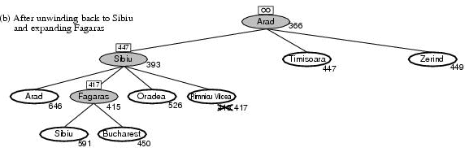
RBFS example
Roll back

Slide 36
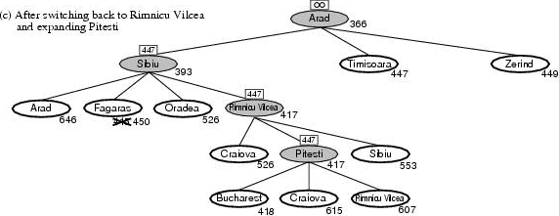
RBFS example
Solution is found since because 447 > 418.

Slide 37
RBFS properties
Like A*, optimal if h(n) is admissible
Time complexity difficult to characterize
Depends on accuracy of h(n) and how often best path changes.
Can end up “switching” back and forth
Space complexity is O(bd)
Other extreme to A* - uses too little memory.

Slide 38
(Simplified) Memory-bounded A* (SMA*)
This is like A*, but when memory is full we delete the worst node (largest f-value).
Like RBFS, we remember the best descendant in the branch we delete.
If there is a tie (equal f-values) we delete the oldest nodes first.
simplified-MA* finds the optimal reachable solution given the memory constraint.
Time can still be exponential.

Slide 39
Heuristic functions
8-puzzle
Avg. solution cost is about 22 steps
branching factor ~ 3
Exhaustive search to depth 22:
3.1 x 10¹⁰ states.
A good heuristic function can reduce the search process.
Two commonly used heuristics
h₁ = the number of misplaced tiles
h₁(s)=8
h₂ = the sum of the distances of the tiles from their goal positions (manhattan distance).
h₂(s)=3+1+2+2+2+3+3+2=18

Slide 40
Notion of dominance
If h₂(n) ≥ h₁(n) for all n (both admissible) then h₂ dominates h₁
h₂ is better for search
Typical search costs (average number of nodes expanded) for 8-puzzle problem
d=12 IDS = 3,644,035 nodes A*(h₁) = 227 nodes A*(h₂) = 73 nodes
d=24 IDS = too many nodes A*(h₁) = 39,135 nodes A*(h₂) = 1,641 nodes

Slide 41
Effective branching factor
Effective branching factor b*
Is the branching factor that a uniform tree of depth d would have in order to contain N+1 nodes.
Measure is fairly constant for sufficiently hard problems.
Can thus provide a good guide to the heuristic’s overall usefulness.

Slide 42
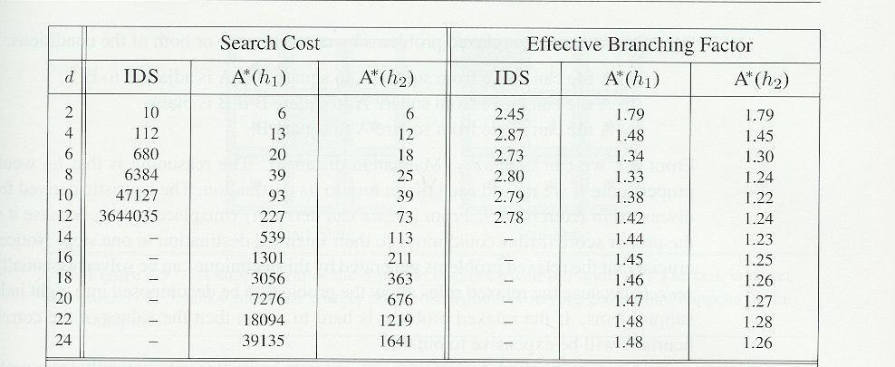
Effectiveness of different heuristics
Results averaged over random instances of the 8-puzzle

Slide 43
Inventing heuristics via “relaxed problems”
A problem with fewer restrictions on the actions is called a relaxed problem
The cost of an optimal solution to a relaxed problem is an admissible heuristic for the original problem
If the rules of the 8-puzzle are relaxed so that a tile can move anywhere, then h₁(n) gives the shortest solution
If the rules are relaxed so that a tile can move to any adjacent square, then h₂(n) gives the shortest solution
Can be a useful way to generate heuristics
E.g., ABSOLVER (Prieditis, 1993) discovered the first useful heuristic for the Rubik’s cube puzzle

Slide 44
More on heuristics
h(n) = max{ h1(n), h2(n),……hk(n) }
Assume all h functions are admissible
Always choose the least optimistic heuristic (most accurate) at each node
Could also learn a convex combination of features
Weighted sum of h(n)’s, where weights sum to 1
Weights learned via repeated puzzle-solving
Could try to learn a heuristic function based on “features”
E.g., x1(n) = number of misplaced tiles
E.g., x2(n) = number of goal-adjacent-pairs that are currently adjacent
h(n) = w₁ x1(n) + w₂ x2(n)
Weights could be learned again via repeated puzzle-solving
Try to identify which features are predictive of path cost

Slide 45
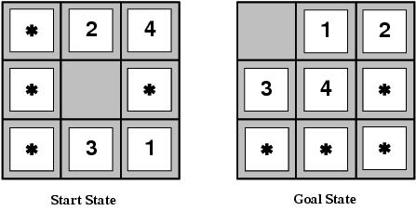
Pattern databases
Admissible heuristics can also be derived from the solution cost of a subproblem of a given problem.
This cost is a lower bound on the cost of the real problem.
Pattern databases store the exact solution to for every possible subproblem instance.
The complete heuristic is constructed using the patterns in the DB

Slide 46
Summary
Uninformed search methods have their limits
Informed (or heuristic) search uses problem-specific heuristics to improve efficiency
Best-first
A*
RBFS
SMA*
Techniques for generating heuristics
Can provide significant speed-ups in practice
e.g., on 8-puzzle
But can still have worst-case exponential time complexity
Next lecture: local search techniques
Hill-climbing, genetic algorithms, simulated annealing, etc

